Slide 1
👁
Hybrid Computer Vision System
for Automated Student Identification
and Behavior Monitoring Using YOLOv8
Ravula Vidya Sri — 2303A52014
S. Nidhi Kathyayini — 2303A52015
A.Sri Chala — 2303A52435
B.TEJASWINI -2303A52001
SR University, Warangal | Subject: AIAC

Slide 2
Introduction
What is it?
A real-time hybrid AI system combining face recognition and pose-based behavior analysis to automate student attendance and classroom monitoring.
Why it matters?
Manual attendance and behavior tracking are time-consuming and error-prone. This system removes human effort and improves accuracy.
Core Technology
YOLOv8 (You Only Look Once v8) is used for ultra-fast object detection, face localization, and human pose estimation in live video feeds.
Outcome
Automated attendance logs, real-time behavior alerts, and a web/mobile dashboard for faculty to monitor classroom activity.

Slide 3
Objectives
🎯
Automated Identification
📋
Attendance Automation
Identify students in real-time using face recognition with YOLOv8 and deep learning embeddings.
Automatically mark attendance by recognizing registered student faces in each class session.
🔍
Behavior Monitoring
📊
Analytics Dashboard
Detect and classify student behaviors (attentive, distracted, sleeping) using pose estimation.
Provide faculty with a dashboard showing attendance trends and behavior analytics per student.
🔒
Privacy & Ethics
📱
Cross-platform Access
Ensure data is stored securely and used only within permitted institutional boundaries.
Make the system accessible via web and mobile interfaces for faculty and administrators.

Slide 4
Stakeholders
Who benefits from this system?
🎓
👩‍🏫
Students
Faculty / Teachers
Transparent, automated attendance records. No proxy attendance. Fair and unbiased tracking.
Saves time on roll calls. Real-time alerts on disruptive behavior. Easy dashboard access.
🏫
👨‍👩‍👧
University Admin
Parents / Guardians
Centralized student data, compliance reporting, and performance insights across departments.
Indirect beneficiaries — transparent attendance records accessible via the student portal.

Slide 5
Programming Languages, Tools & Software
Languages
AI / ML Libraries
Frameworks & Tools
Python 3.10+
YOLOv8 (Ultralytics)
Flask / FastAPI
HTML / CSS / JS
OpenCV
React.js (Frontend)
SQL (SQLite)
DeepFace / FaceNet
Git & GitHub
NumPy / Pandas
VS Code / Colab
AI Tools Used: ChatGPT (code generation) | Claude (architecture review) | GitHub Copilot

Slide 6
Prompts Used to Generate the Code
01
"Create a Python script using YOLOv8 and OpenCV that detects and recognizes student faces from a webcam feed in real-time."
02
"Write a Flask API endpoint that receives a video frame, runs face recognition, and returns the matched student ID and confidence score."
03
"Using YOLOv8 pose estimation, classify student behavior as attentive, distracted, or sleeping based on head and body keypoints."
04
"Build a React.js dashboard that displays live attendance status, student thumbnails, and behavior alerts from the Flask backend."
05
"Generate an SQLite database schema to store student profiles, attendance records, and behavior logs with timestamps."

Slide 7
System Workflow
1. Camera
Input
2. Frame
Preprocessing
3. YOLOv8
Detection
4. Face
Recognition
5. Behavior
Analysis
↓ connect
6. Match
Database
7. Log
Attendance
8. Behavior
Alert
9. Update
Dashboard
10. Faculty
Notification
Flow: Camera Feed → AI Processing → Database Matching → Real-time Dashboard
Input / Processing
Output / Action

Slide 8
Front-End View — Web Dashboard
http://localhost:5000/dashboard
📊 Dashboard
📋 Attendance
👥 Students
⚠️ Alerts
⚙️ Settings
📹 Live Camera Feed
[ Student Face Detection Active ]
✅ Today's Attendance
Present: 42 / 60
Absent: 18
🧍 Behavior Status
Attentive: 35 Distracted: 5
Sleeping: 2
⚠️ Alerts
! Student not recognized
! Sleeping detected - Row 3

Slide 9
Proof of Prompts Generating Code
Screenshots demonstrating AI-generated code from prompts
ChatGPT — YOLOv8 Face Detection Code
ChatGPT — Flask API Endpoint
from ultralytics import YOLO
model = YOLO("yolov8n-face.pt")
results = model(frame, stream=True)
for r in results:
boxes = r.boxes # Face boxes
@app.route("/identify", methods=["POST"])
def identify_student():
frame = request.json["frame"]
student_id = run_recognition(frame)
return jsonify({"id": student_id})
Claude — Behavior Classification Logic
Copilot — SQLite Attendance Schema
def classify_behavior(keypoints):
head_y = keypoints["nose"][1]
shoulder_y = keypoints["shoulder"][1]
if head_y > shoulder_y * 1.3:
return "sleeping"
return "attentive"
CREATE TABLE attendance (
id INTEGER PRIMARY KEY,
student_id TEXT,
timestamp DATETIME,
status TEXT
);

Slide 10
References
[1]
Ultralytics YOLOv8 Documentation
Ultralytics Inc., 2023. YOLOv8: The latest version of YOLO for object detection, segmentation, and pose estimation. https://docs.ultralytics.com
[2]
OpenCV Library
Bradski, G. (2000). The OpenCV Library. Dr. Dobb's Journal of Software Tools. https://opencv.org
[3]
DeepFace Framework
Serengil, S. I., & Ozpinar, A. (2020). LightFace: A Hybrid Deep Face Recognition Framework. IEEE ASYU Conference.
[4]
Face Recognition with Deep Learning
Schroff, F., Kalenichenko, D., & Philbin, J. (2015). FaceNet: A Unified Embedding for Face Recognition. CVPR 2015.
[5]
Flask Web Framework
Grinberg, M. (2018). Flask Web Development: Developing Web Applications with Python. O'Reilly Media.
[6]
React.js Documentation
Meta Open Source. (2023). React — The library for web and native user interfaces. https://react.dev
SR University, Warangal | AIAC | 2025–26

Slide 11
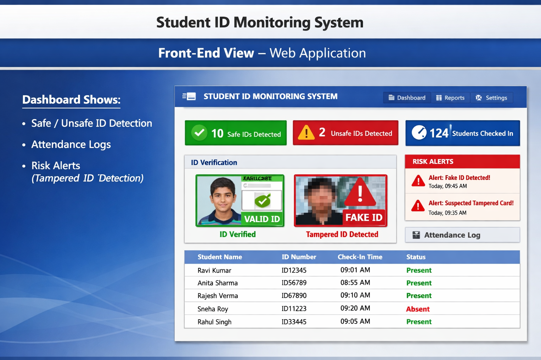
SR University, Warangal | AIAC | 2025–26

